Slide 1
Unit I

Slide 2
INTRODUCTION TO SOFTWARE
Software is a set of instructions used to acquire inputs and to manipulate them to produce the desired output in terms of functions and performance as determined by the user of the software.
It also includes a set of documents, such as the software manual, meant to help users understand the software system.
Today’s software is comprised of Source Code, Executables, Design Documents, Operations, and System Manuals and Installation and Implementation Manuals.

Slide 3
Software includes:
(i) Instructions (computer programs) that when executed provide desired
functions and performance.
(ii) Data structures that enable the programs to adequately manipulate
information.
(iii) Documents that describe the operation and use of the programs.
Definition of software given by the IEEE:
Software is the collection of computer programs, procedure rules and associated documentation and data.

Slide 4
Importance of Software
Computer software has become a driving force.
It is the engine that drives business decision making.
It serves as the basis for modern scientific investigation and engineering problem-solving.
It is embedded in all kinds of systems, such as transportation, medical, tele- communications, military, industrial processes, entertainment, office products, etc.

Slide 5
SOFTWARE CHARACTERISTICS
The key characteristics of software are as follows:
1. Most software is custom-built, rather than assembled from existing components. Most software continues to be custom built, although recent developments tend to be component-based. Modern reusable components encapsulate both data and the processing applied to data, enabling the software engineer to create new applications from reusable parts. For example, today a GUI is built using reusable components that enable the creation of graphics windows, pull-down menus, and a wide variety of interaction mechanisms. The data structures and processing details required to build the interface are contained in a library of reusable components for interface construction.
2. Software is developed or engineered; it is not manufactured in the classical sense. Although some similarities exist between software development and hardware manufacturing, the two activities are fundamentally different. In both activities, high quality is achieved through good design, but the manufacturing phase for hardware can introduce quality problems that are non existent for software. Both activities depend on people, but the relationship between people applied and work accomplished is entirely different. Both require the construction of a “product.” But the approaches are different. Software costs are concentrated in engineering. This means that software projects cannot be managed as if they were manufacturing projects.

Slide 6
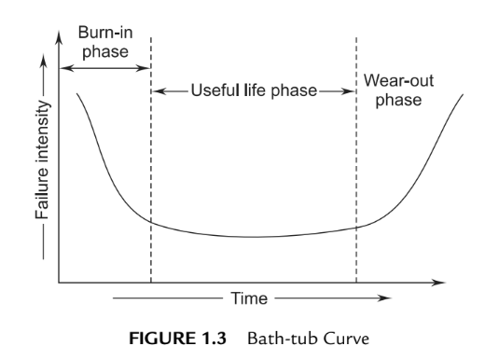
Software is flexible. We all feel that software is flexible. A program can be developed to do almost anything. Sometimes, this characteristic may be the best and may help us to accommodate any kind of change. Reuse of components from libraries help in reduction of effort. Now-a-days, we reuse not only algorithms but also data structures.
Software doesn’t wear out. There is a well-known “bath-tub curve” in reliability studies for hardware products. Figure 1.3 depicts the failure rate as a function of time for hardware. The relationship is often called the “bath-tub curve.”

Slide 7
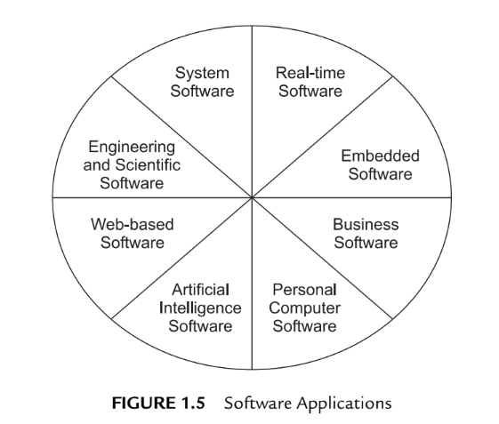
SOFTWARE APPLICATION DOMAINS
Software applications are grouped into eight areas for convenience as shown in Figure 1.5.

Slide 8
System Software: System software is a collection of programs used to run the system as an assistance to other software programs. The compliers, editors, utilities, operating system components, drivers, and interfaces are examples of system software. This software resides in the computer system and consumes its resources. A computer system without system software cannot function.
System software directly interacts with the hardware, heavy usage by multiple users, concurrent operations that require scheduling, resource sharing, and sophisticated process management, complex data structures, and multiple external interfaces.
Real-time Software: Real-time software deals with a changing environment. First, it collects the input and converts it from analog to a digital, control component that responds to the external environment and performs the action.
The software is used to monitor, control, and analyze real-world events as they occur. Examples include Rocket launching, games, etc.

Slide 9
Embedded software—resides within a product or system and is used to implement and control features and functions for the end user and for the system itself. Embedded software can perform limited and esoteric functions (e.g., key pad control for a microwave oven) or provide significant function and control capability (e.g., digital functions in an automobile such as fuel control, dashboard displays, and braking systems).
Business Software. Software designed to process business applications is called business software. Business software can be a data- and information- processing application. It can drive the business process through transaction processing in on-line or in real-time mode.
This software is used for specific operations, such as accounting packages, management information systems, payroll packages, and inventory management. Business software restructures existing data in order to facilitate business operations or management decision-making. It also encompasses interactive computing. It is integrated software related to a particular field.

Slide 10
Personal Computer Software. Word processing, spreadsheets, computer graphics, multimedia, entertainment, database management, personal and business financial applications, external networks, or database access are only a few of hundreds of applications.
Web applications—called “WebApps,” this network-centric software category spans a wide array of applications. In their simplest form, WebApps can be little more than a set of linked hypertext files that present information using text and limited graphics. However, as Web 2.0 emerges, WebApps are evolving into sophisticated computing environments that not only provide stand-alone features, computing functions, and content to the end user, but also are integrated with corporate databases and business applications.

Slide 11
Engineering and Scientific Software: The design and engineering of scientific software deals with processing requirements in their specific fields. They are written for specific applications using the principles and formulae of each field.
These software applications service the need for drawing, drafting, modeling, lead calculations, specifications-building, and so on. Dedicated software is available for stress analysis or for analysis of engineering data, statistical data for interpretation, and decision-making. CAD/CAM/CAE packages, SPSS, MATLAB, and circuit analyzers are typical examples of such software.
Artificial-intelligence Software: Artificial-intelligence software uses non-numerical algorithms, which use the data and information generated in the system to solve complex problems. These problem scenarios are not generally amenable to problem-solving procedures, and require specific analysis and interpretation of the problem to solve it.
Applications within this area include robotics, expert systems, pattern recognition (image and voice), artificial neural networks, theorem proving and game playing, and signal-processing software.

Slide 12
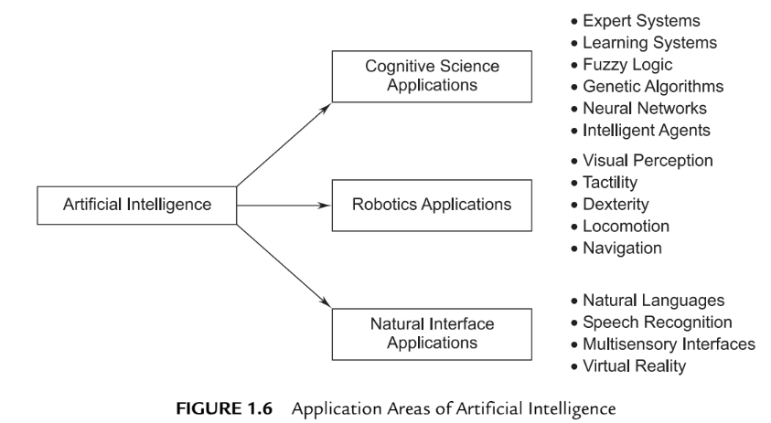

Slide 13
Legacy Software
A legacy system is not necessarily defined by age. Legacy may refer to lack of vendor support or a system's incapacity to meet organizational requirements. For example, a large mainframe may use a 64-bit Java, while a Linux platform might utilize code from the 1960s. Legacy conditions refer to a system's difficulty (or inability) to be maintained, supported or improved. A legacy system is usually incompatible with newly purchased systems.
Legacy systems are high maintenance and may involve intricate patching and modifications. Porting techniques are often used for software adjustments or adaptation. Older hardware may require added compatibility layers to facilitate device functionality in incompatible environments.

Slide 14
In IT, a legacy system is one that's old and outdated, but still in use. A legacy system might be an antique piece of computer hardware, an application that's past its prime, or some old-fashioned process... or all of the above.

Slide 15
An organization might continue to use legacy systems for a wide range of reasons, such as the following:
"If it ain't broke, don't fix it!" The system might work adequately.
The system is complex, and documentation is poor. Simply defining scope can be difficult.
A redesign is costly, due to complexity or monolithic architecture.

Slide 16
Why are legacy systems still used?
Legacy systems tend to stick around because they still work and get the job done (if it ain't broke, then don't fix it). Often, they're so old that no one knows exactly how they work anymore or what dependencies they might have, so it could be risky to replace them.
This problem can be made worse when the vendor that created the legacy hardware or software goes out of business, making performing updates or upgrades much harder. Additional difficulties arise when the employees who deployed these systems left long ago without leaving adequate documentation.
Another reason you'll encounter legacy systems is because they're so expensive to replace that a company can't afford to switch to a newer version. Or perhaps the legacy application requires proprietary hardware, so you're stuck with really old hardware you can't replace. As a result, you might find ancient, discolored systems next to brand new servers running the latest and greatest of everything.

Slide 17
Legacy Systems Concerns
The big problem with legacy systems is that they are often so old, they're more prone to failure and they could cost a lot of money to fix when they do. Not only are old parts often hard to find, tracking down someone with the expertise to fix or modify decades-old software could be a very expensive proposition.
Additionally, legacy systems pose a big security risk. With legacy devices, the operating systems and firmware running on them probably haven't been updated in a long time. And because they're probably no longer supported, new exploits discovered on legacy systems might never be patched.

Slide 18
Legacy Systems Examples
Hardware in power plants that's so old, the only functioning replacement parts are in the Smithsonian Museum, and the only qualified techs that can repair it are all retired
A still-in-use voicemail system that uses both software and hardware from 1993
Software that keeps score in bowling alleys that runs on Zilog Z80 or Intel 486 machines
A manufacturing machine controlled by decades-old computer running MS-DOS
Financial software running on an outdated Apple IIGS machine because "it still works"
Electronic microscopes powered by Windows 95 computers
Software that requires you to plug a dongle into a parallel port for copy protection purposes, so you're forced to use an ancient system
Sales terminals running on Intel 286 computers because the software is incompatible with anything newer
US Department of Defense computers used to operate nuclear weapons still running on computers from the 1970s at a cost of billions of dollars each year to taxpayers

Slide 19
INTRODUCTION TO SOFTWARE ENGINEERING
Software engineering eventually results in a product that is efficient and effective at solving a problem or fulfilling a duty. Following software engineering principles helps to ensure that the product is reliable and safe for customers.
IEEE Comprehensive Definition. Software Engineering is the application of a systematic, disciplined, quantifiable approach to the development, operation and maintenance of software, i.e., the application of engineering to software.
Other Definitions. Software Engineering deals with cost-effective solutions to practical problems by applying scientific knowledge in building software artifacts in the service of mankind.
OR
Software Engineering is the application of methods and scientific knowledge to create practical cost-effective solutions for the design, construction, operation and maintenance of software.

Slide 20

Software-Engineering Principles
A layered approach

Slide 21
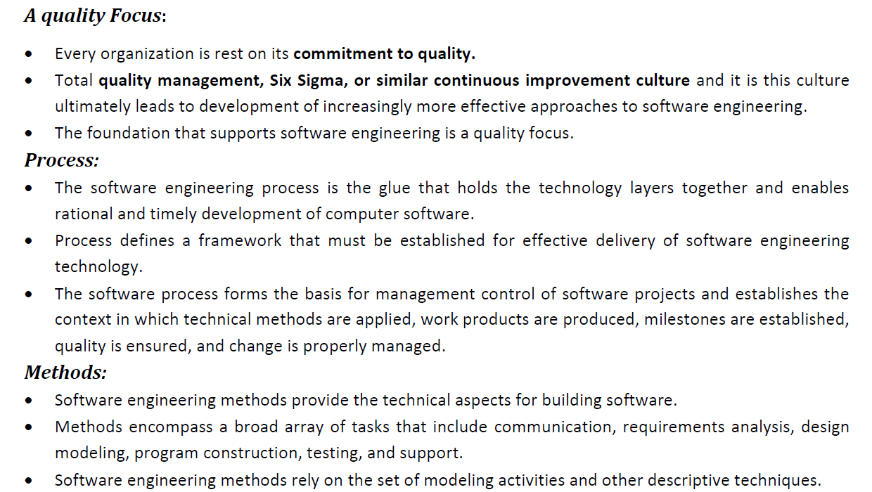

Slide 22
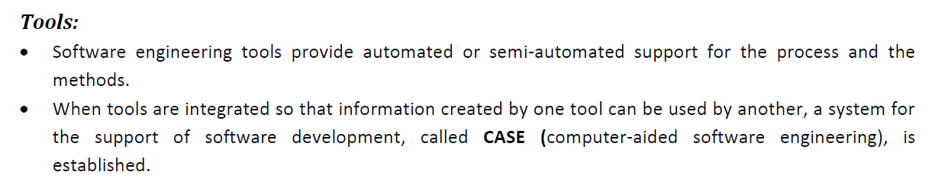

Slide 23
THE SOFTWARE PROCESS
A process is a collection of activities, actions, and tasks that are performed when some work product is to be created.
An activity strives to achieve a broad objective (e.g., communication with stakeholders) and is applied regardless of the application domain, size of the project, complexity of the effort, or degree of rigor with which software engineering is to be applied.
An action (e.g., architectural design) encompasses a set of tasks that produce a major work product (e.g., an architectural design model).
A task focuses on a small, but well-defined objective (e.g., conducting a unit test) that produces a tangible outcome.

Slide 24
In the context of software engineering, a process is not a rigid prescription for how to build computer software. Rather, it is an adaptable approach that enables the people doing the work (the software team) to pick and choose the appropriate set of work actions and tasks.
A process framework establishes the foundation for a complete software engineering process by identifying a small number of framework activities that are applicable to all software projects, regardless of their size or complexity. In addition, the process framework encompasses a set of umbrella activities that are applicable across the entire software process. A process framework establishes the foundation for a complete software engineering process by identifying a small number of framework activities that are applicable to all software projects, regardless of their size or complexity. In addition, the process framework encompasses a set of umbrella activities that are applicable across the entire software process.

Slide 25
A generic process framework for software engineering encompasses five activities:
Communication. Before any technical work can commence, it is critically important to communicate and collaborate with the customer and other stakeholders. The intent is to understand stakeholders’ objectives for the project and to gather requirements that help define software features and functions.
Planning. Any complicated journey can be simplified if a map exists. A software project is a complicated journey, and the planning activity creates a “map” that helps guide the team as it makes the journey. The map—called a software project plan—defines the software engineering work by describing the technical tasks to be conducted, the risks that are likely, the resources that will be required, the work products to be produced, and a work schedule.
Modeling. Modeling is to understand the big picture—what it will look like architecturally, how the constituent parts fit together, and many other characteristics. If required, the sketch is redefined into greater and greater detail in an effort to better understand the problem and identifying the solution. A software engineer does the same thing by creating models to better understand software requirements and the design that will achieve those requirements.

Slide 26
Construction. This activity combines code generation (either manual or automated) and the testing that is required to uncover errors in the code.
Deployment. The software (as a complete entity or as a partially completed increment) is delivered to the customer who evaluates the delivered product and provides feedback based on the evaluation.

Slide 27
Umbrella Activities:
Software engineering process framework activities are complemented by a number of umbrella activities.
These are:
Software project tracking and control—allows the software team to assess progress against the project plan and take any necessary action to maintain the schedule.
Risk management—assesses risks that may affect the outcome of the project or the quality of the product.
Software quality assurance—defines and conducts the activities required to ensure software quality.
Technical reviews—assesses software engineering work products in an effort to uncover and remove errors before they are propagated to the next activity.
Measurement—defines and collects process, project, and product measures that assist the team in delivering software that meets stakeholders’ needs; can be used in conjunction with all other framework and umbrella activities.
Software configuration management—manages the effects of change throughout the software process.
Reusability management—defines criteria for work product reuse (including software components) and establishes mechanisms to achieve reusable components.
Work product preparation and production—encompasses the activities required to create work products such as models, documents, logs, forms, and lists.

Slide 28
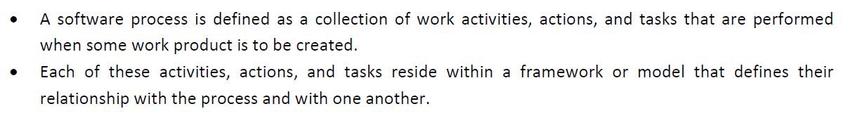
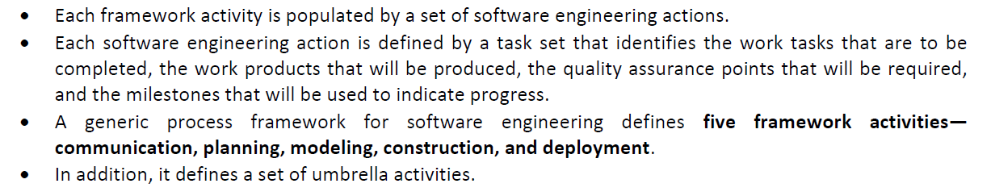
A GENERIC PROCESS MODEL

Slide 29
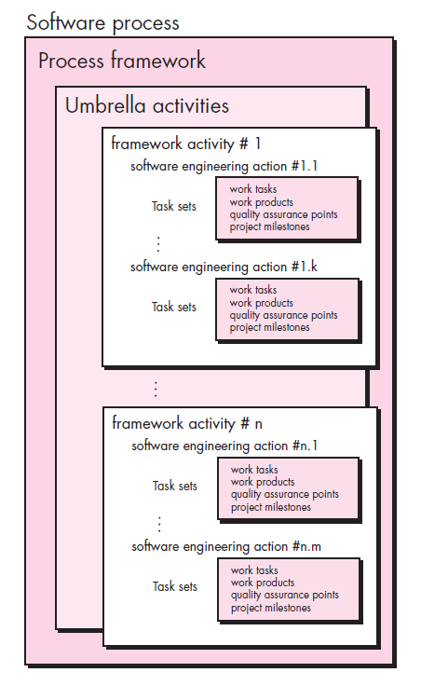

Slide 30
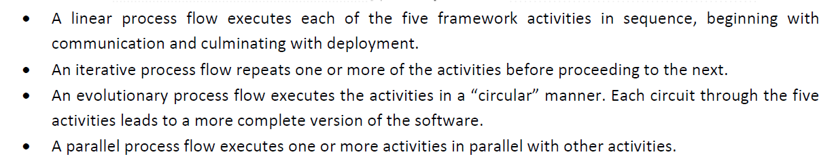
PROCESS FLOW

Slide 31
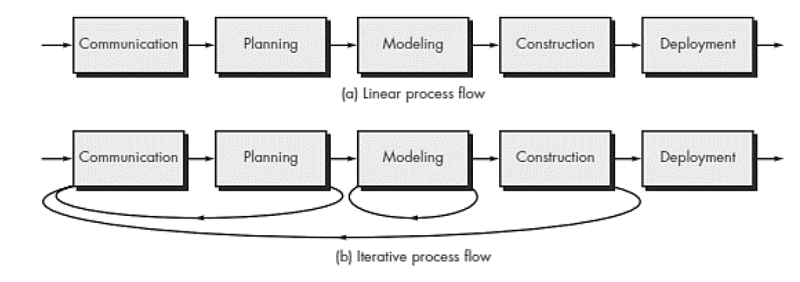

Slide 32
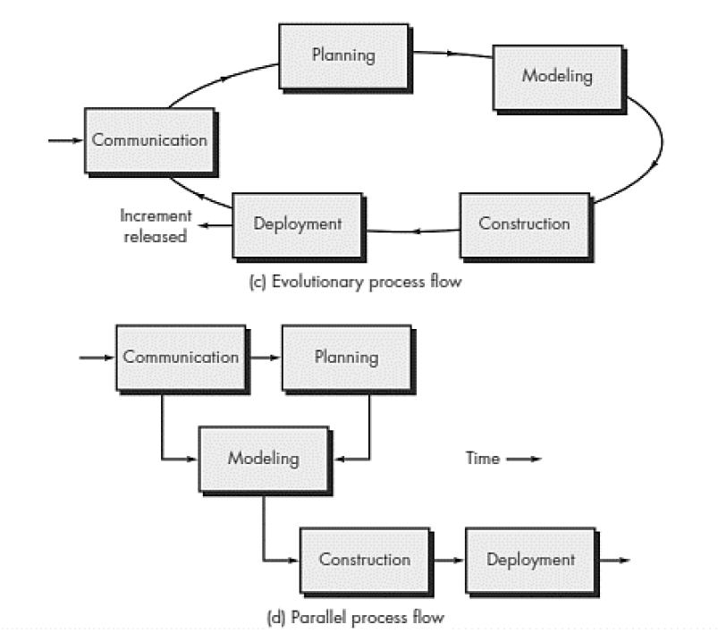

Slide 33
Generic framework focuses on the following:
Defining a Framework Activity
Identifying a Task Set
Process Patterns

Slide 34
a) Defining a Framework Activity
A software team would need significantly more information before it could properly execute any one of these activities as part of the software process.
Therefore, key questions: What actions are appropriate for a framework activity, given the nature of the problem to be solved, the characteristics of the people doing the work, and the stakeholders who are sponsoring the project?

Slide 35
b) Identifying a Task Set
Each software engineering action (e.g., elicitation, an action associated with the communication activity) can be represented by a number of different task sets—each a collection of software engineering work tasks, related work products, quality assurance points, and project milestones.
You should choose a task set that best accommodates the needs of the project and the characteristics of your team. This implies that a software engineering action can be adapted to the specific needs of the software project and the characteristics of the project team.

Slide 36
c) Process Patterns
A process pattern describes a process-related problem that is encountered during software engineering work, identifies the environment in which the problem has been encountered, and suggests one or more proven solutions to the problem.
Ambler [Amb98] has proposed a template for describing a process pattern:
Pattern Name. The pattern is given a meaningful name describing it within the context of the software process (e.g., Technical Reviews).
Forces. The environment in which the pattern is encountered and the issues that make the problem visible and may affect its solution.
Type. The pattern type is specified.
Initial context. Describes the conditions under which the pattern applies.
Prior to the initiation of the pattern: (1) What organizational or team-related activities have already occurred? (2) What is the entry state for the process? (3) What software engineering information or project information already exists?

Slide 37
Ambler [Amb98] suggests three types:
1. Stage pattern—defines a problem associated with a framework activity for the process. Since a framework activity encompasses multiple actions and work tasks, a stage pattern incorporates multiple task patterns (see the following) that are relevant to the stage (framework activity). An example of a stage pattern might be Establishing Communication. This pattern would incorporate the task pattern Requirements Gathering and others.
2. Task pattern—defines a problem associated with a software engineering action or work task and relevant to successful software engineering practice (e.g., Requirements Gathering is a task pattern).
3. Phase pattern—define the sequence of framework activities that occurs within the process, even when the overall flow of activities is iterative in nature. An example of a phase pattern might be Spiral Model or Prototyping.

